Slide 1

Biodiversity
Notes:
FM

Slide 2
Book Chain Project Annual Seminar – Jake White, HoLA, WWF-UK

Slide 3
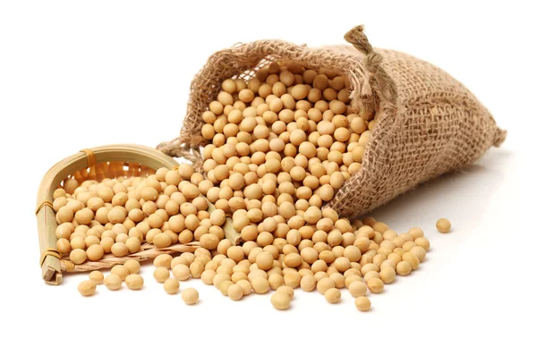
Intro & disclaimer!
WWF-UK…
Food goal
Soft commodities
Deforestation – but timber / pulp not
top priority
Not going to talk about Book Chain!
Can talk about other commodities and deforestation…

Slide 4
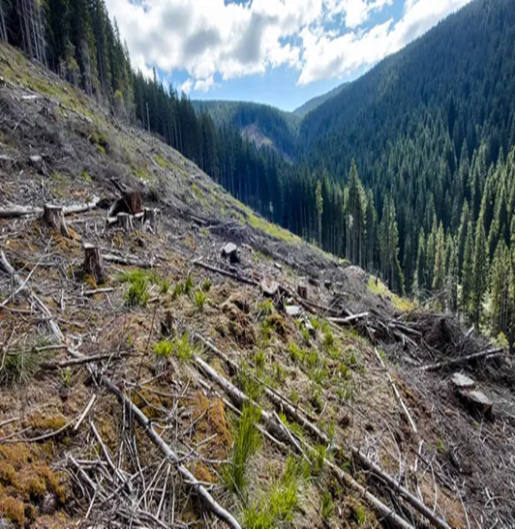
Nature in crisis (1)
global wildlife populations declined 69%
since 1970 (LPR WWF)
¼ all mammals at risk of extinction (IPBES)
insect populations down 60 – 64%
UK bottom 10% of most nature depleted
countries

Slide 5
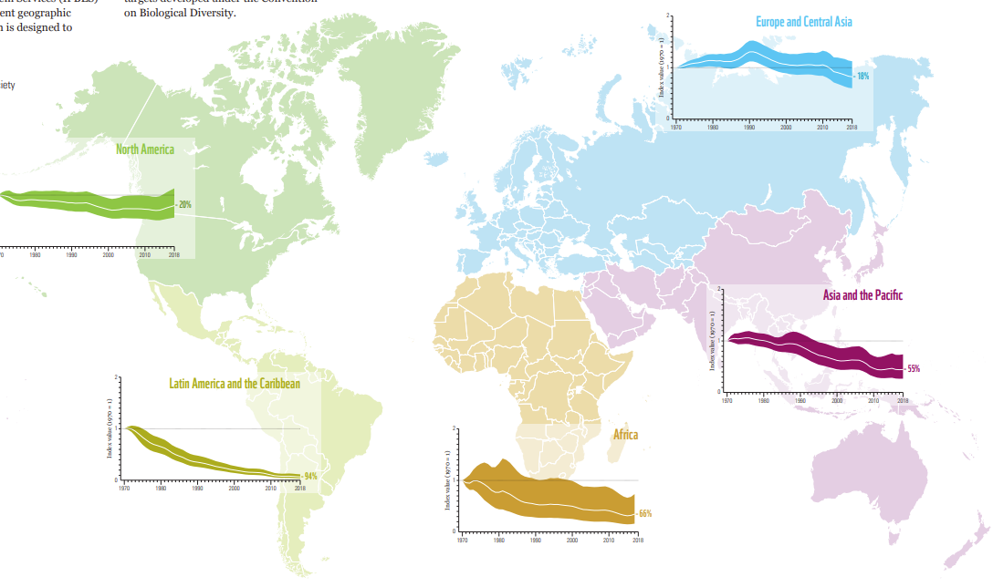
Nature in crisis (2)
Advocacy legal team update – May 23

Slide 6
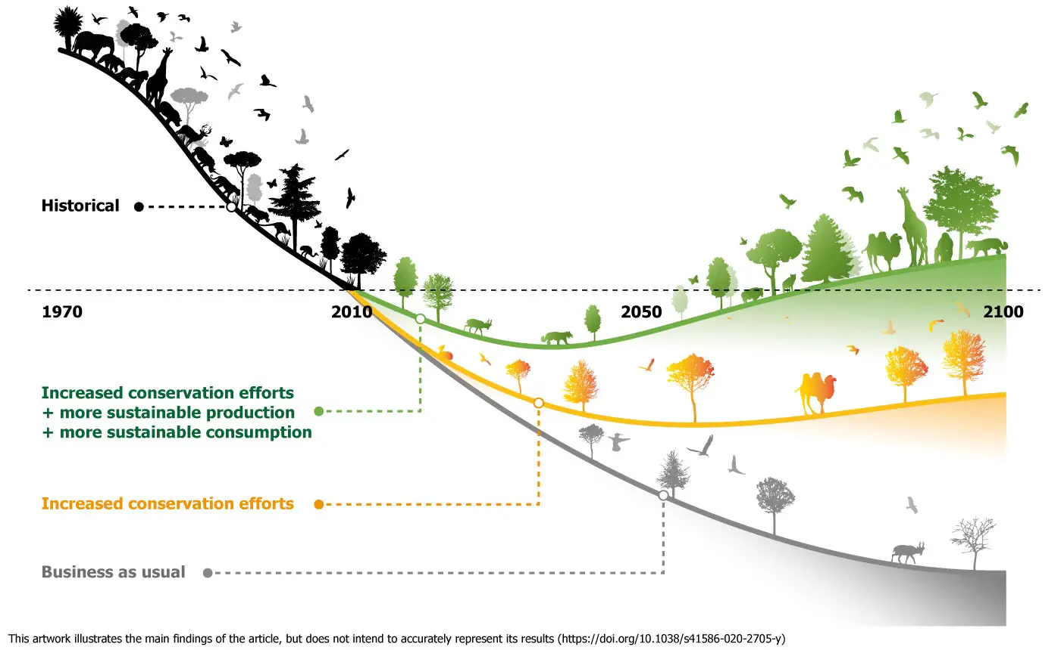
Nature in crisis (2)

Slide 7

Why does this matter? (Rhetorical)
food, air, shelter, clothing, medicines…
50% of global GDP directly depends on natural resources
Das Gupta: economics of biodiversity
mental health and wellbeing –
“green social prescribing”
beauty and richness of natural world

Slide 8
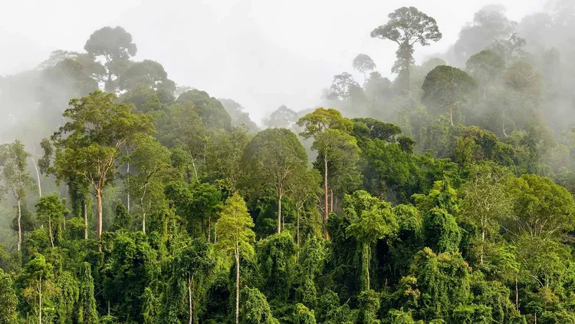
What is changing? (1)
Consumer Goods Forum (2010)
Amsterdam & New York Declarations on Forests (2015)
IPBES report (2018)
Das Gupta Review for UK Treasury (2021)
CBD – Kunming Montreal Framework (2022)
Regulation
Consumer attitudes – way ahead…

Slide 9

What is changing? (2)
Regulation
UK DD regime implementing regs before summer recess?
Environment Act targets (woodland)
TCFD: FCA rules in force
Transition Plan Taskforce – report Sept 23?
TNFD: coming…
EU Deforestation Regulation (Official Journal?)
EU corporate sustainability due diligence directive (EP agreed position)
Notes:
Woodland target – 16.5% by 2050…

Slide 10

What is changing? (2)
More broadly
SBTN, ISSB, industry led
EU Nature Restoration Law (?)
US Forest Act (2021)
Lacey Act (1900!)
Financial Services & Markets Act
  new duty on regulator
  duty on HMT to report on extending DD regime to finance
Notes:
Woodland target – 16.5% by 2050…

Slide 11
Is business stepping up?
3% UK businesses monitor nature and biodiversity risks to their business
1% business know level of dependency on nature
5% carried out science-based assessment
Advocacy legal team update – May 23

Slide 12

Case studies?
Cargill & big 4
Nestle?
Unilever?
Tesco?
Drax?
Advocacy legal team update – May 23

Slide 13
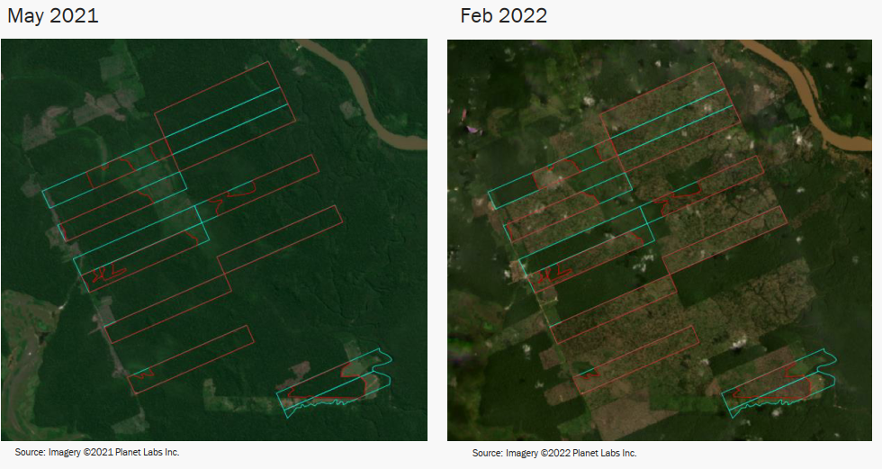
Case studies? (2)
Practical problems
indirect supply
technical difficulties
vertical integration
tech solutions
science based targets
(eg: traders’ road map)
Advocacy legal team update – May 23

Slide 14

Risks
non-standardisation of industry-led initiatives
accountability / effective grievance mechanisms?
high customer expectations
unsubstantiated claims
regulatory action ASA / greenwashing
reputational risk
legal risk

Slide 15

Legal risk
Parent company / due diligence claims
Vedanta – Zambian copper mine: subsidiary
Mariana dam case – Brasilian
dam collapse (BHP Billiton JV)
Begum – shipbreaking case: Maran UK Ltd
BAT – forced labour in Malawi (farms)
Dyson - forced labour in Malaysia (factory)
representative actions – persons with “same interest”
Notes:
inadequate policies,
holding out as supervising when failing to do so

