Slide 1
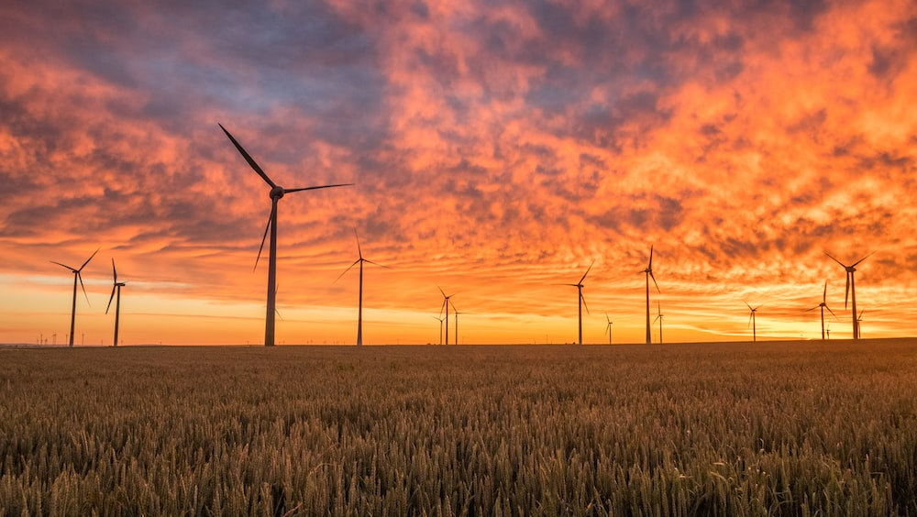
Climate action in the supply chain

Slide 2


Bookchain: climate action IN supply chains

Slide 3






WHO WE ARE
WE Galvanize Global business into climate leadership
7x
50x
1x
7,500x
Secretariat
Coalition
partners
Strategic
and implementation
partners
Global business
Beyond the Coalition,
our partners are the
leading organizations
working on climate
action around the world.
Together, we remove
obstacles, champion the progress and lead the global business community towards climate leadership.

Slide 4





MOVING Business to halve emissions by 2030
OUR STRATEGY
THE 4A FRAMEWORK
BUSINESS
AMBITION
ACTION
ADVOCACY
ACCOUNTABILITY

Slide 5
















Corporate CLIMATE LEADERSHIP
4A Framework
AMBITION
ACTION
Demonstrate the highest level of ambition with SBTi
Go further, faster by joining the RacetoZero
Support suppliers and SMEs through the SME Climate Hub
Engage in demand side initiatives
Collaborate with sectoral initiatives to drive supply side action
Engage across supply chains to tackle scope 3 emissions
Invest in nature
ACCOUNTABILITY
ADVOCACY
s
s
Say on Climate – Transition Action Plans
Report progress and engage in the 2023 Global stock take
Integrate climate in company boards
Implement TCFD/ISSB
Make your voice heard
Engage with trade association
Collaborate with organizations like WMB to drive the ambition loop
Target national and sectoral legislation

Slide 6


Mobilising millions of small and medium businesses to achieve net zero

Slide 7

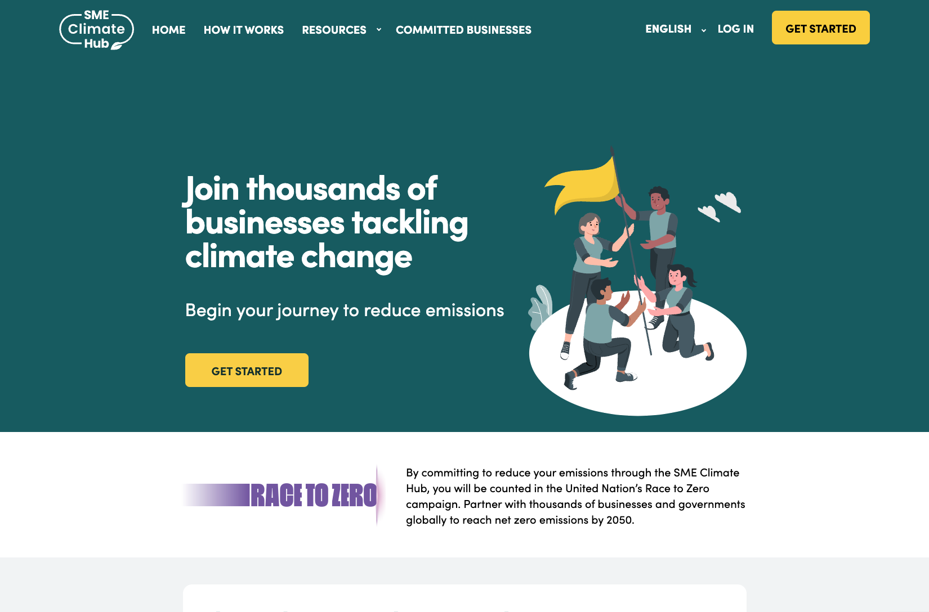
What is the SME Climate Hub?
The SME Climate Hub provides small and medium sized enterprises (SMEs) with a one-stop-shop to:
1
Commit to climate targets​ aligned with 1.5°C
Access free, best-in-class tools to measure emissions, act & report progress
Benefit from incentives to reduce emissions
2
3
The SME Climate Hub is an initiative of the We Mean Business Coalition, the Exponential Roadmap Initiative, and the United Nations Race to Zero campaign.
The initiative is the official pathway for SMEs to join the United Nations Race to Zero campaign. Over 6,300 SMEs from 125+ countries have made the commitment.
SMEClimateHub.org
7

Slide 8

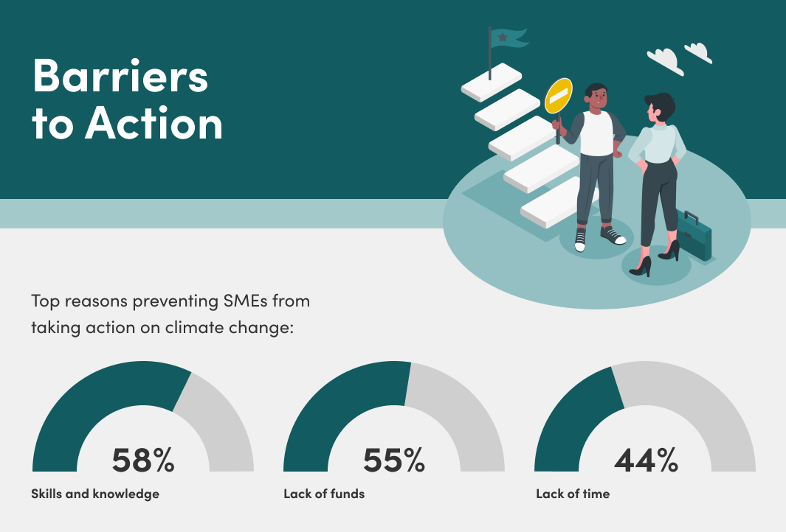
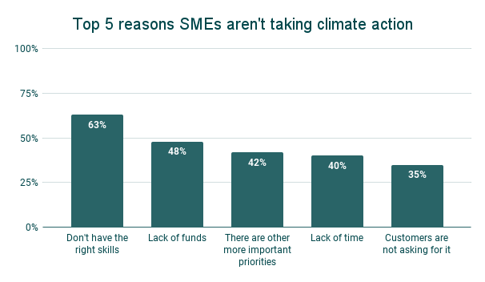
Why SMEs?
KEY ROLE IN COMMUNITIES & SUPPLY CHAINS
SMEs make up 90% of businesses worldwide and employ over 2 billion people.
NEED FOR ADAPTATION
40% to 60% of small businesses never reopen after a disaster.
SPECIFIC BUSINESS CHALLENGES
Survey of our SMEs highlight key challenges around resources, know-how and incentives.
SMEClimateHub.org
8

Slide 9

The Hub
How it works – start your journey to net zero
1
SEE WHERE YOU STAND
Use our tools to help take the first steps, from measuring your emissions to learning more about small business climate action.
PUBLICALLY COMMIT
Make a simple, credible public commitment and join thousands of other businesses in the UN Race to Zero.
TAKE ACTION
Unlock resources and incentives to help you identify the right actions, report on progress and get recognized.
2
3
SMEClimateHub.org
9

Slide 10


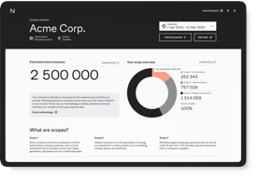
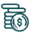



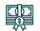



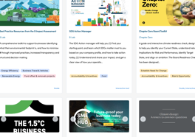
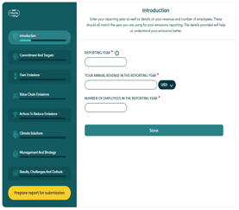









The key tools
Accessing free tools on education, measurement and reporting
CLIMATE FIT
BUSINESS CARBON CALCULATOR
FINANCIAL SUPPORT GUIDE
A practical step-by-step guide to help SMEs reduce emissions across their business – from operations to supply chain to messaging.
Assesses SMEs’ Scope 1, 2 and 3 emissions following the Greenhouse Gas Protocol.
Explains and improves access to financial support for SMEs working to reduce their carbon emissions.
OTHER TOOLS
REPORTING TOOL
COMING SOON!
Library of practical tools and resources curated by the Net Zero team at Oxford University.
Enables SMEs to report GHG emissions, climate actions, and impact of emission reductions
Action-specific
Modules.
SMEClimateHub.org
10
Enables SMEs to report GHG emissions, climate actions, and impact of emission reductions

